Slide 1

Amazon Laptop Market Analysis
Presented By:
Saraff Vineetha
Batch :543

Slide 2
About ME:
B-Tech(Information Technology)
Passed out Year: 2026
I chose Data Analytics because I enjoy working with data, solving problems, and finding useful patterns that help businesses make better decisions.
LinkedIn: www.linkedin.com/in/saraff-vineetha-787779416
GitHub: https://github.com/saraffsvinitha-blip/-Saraff-Vineetha

Slide 3
Agenda :
Business Problem
Business Statement
Objective
Introduction
Data description
Data Cleaning
Analysis
Insights
Testing
Recommendations
Conclusion
Q&A Slide

Slide 4
Business Problem :
The laptop market offers a wide range of products with different brands, models, RAM, ROM, processors, operating systems, prices, discounts, and customer ratings. With so many choices, customers may find it difficult to compare laptops and identify the best product according to their budget and requirements. Businesses also need to understand which brands and specifications are popular, how prices vary across products, and whether discounts and ratings influence customer choices. This project analyzes Amazon laptop data to identify product trends, pricing patterns, popular configurations, discount levels, and customer ratings.

Slide 5
Business Statement:
The purpose of this project is to collect and analyze Amazon laptop product data using web scraping techniques. The analysis focuses on important attributes such as brand, model, RAM, ROM, processor, price, discount, rating, and customer reviews. The project aims to identify patterns and relationships among product specifications, pricing, discounts, and customer engagement. By applying data cleaning, Exploratory Data Analysis (EDA), and statistical analysis, the project generates meaningful insights that can support better product comparison, pricing, and promotional decisions.

Slide 6
Objectives:
Analyze 324 laptop records and identify market trends.
Compare brands based on price, discount, and rating.
Identify popular laptop specifications such as RAM, ROM, and processor.
Analyze budget, mid-range, and premium price segments.
Study the relationship between price and rating.
Identify highly rated and best-value laptops.
Analyze discount patterns across different brands and products.
Compare processor and operating system categories to identify popular choices.
Generate data-driven recommendations for customers and businesses.

Slide 7
Introduction:
Amazon offers a wide range of laptops from different brands and price segments.
Each laptop has different RAM, ROM, processor, price, discount, and rating.
This project analyzes 324 Amazon laptop records using data analytics.
The analysis identifies product trends, pricing patterns, popular specifications, and customer ratings.
The insights help customers make better purchasing decisions and businesses make data-driven decisions.

Slide 8
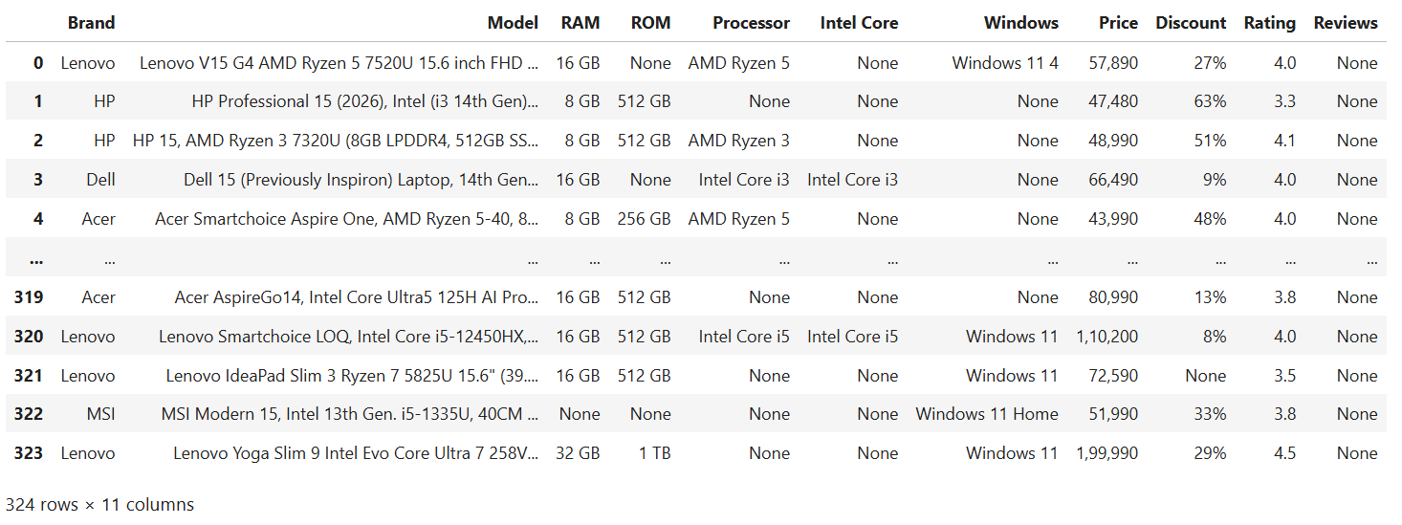
Data Description:

Slide 9
Data Cleaning:
Removed missing values from the dataset.
Checked and removed duplicate records.
Removed unwanted symbols and commas.
Converted Price, Rating, RAM, ROM, and Discount into numeric formats.
Standardized data types and formats.
Prepared the final dataset of 324 records and 10 columns for EDA.

Slide 10
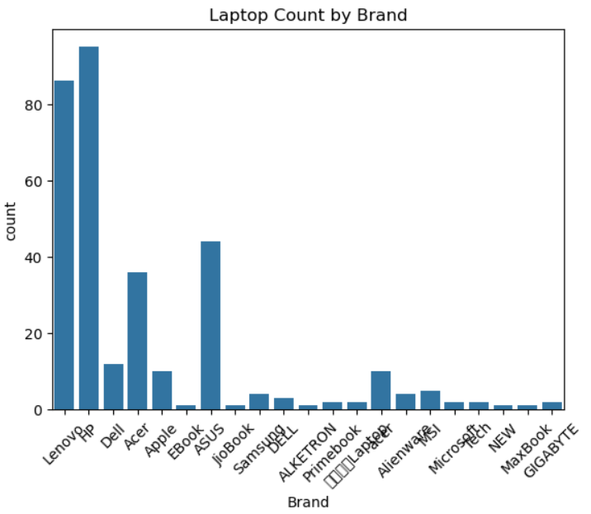
Univariate Analysis
Laptop Count by Brand:
HP and Lenovo lead the dataset
(~95 and ~86 laptops).
Most other brands have very few, and brand names
need cleaning. Because of this imbalance,
brand price averages should be interpreted with caution

Slide 11
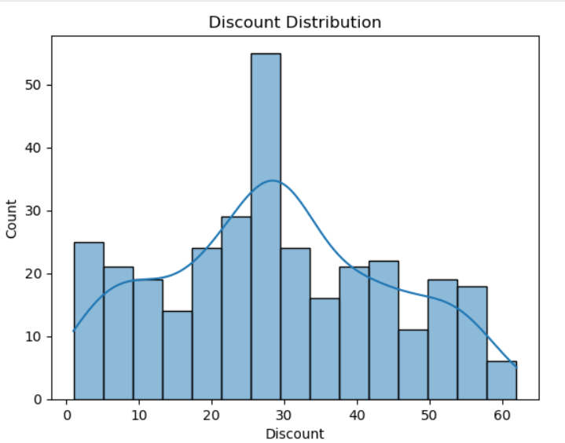
Discount Distribution:
Most discounts fall between 20%
and 45%, peaking at about 25 to
30%. Very high discounts
(above 55%) are rare.
The distribution is roughly
bell-shaped with a slight
right skew, so most laptops get
moderate discounts rather than
extreme ones.

Slide 12
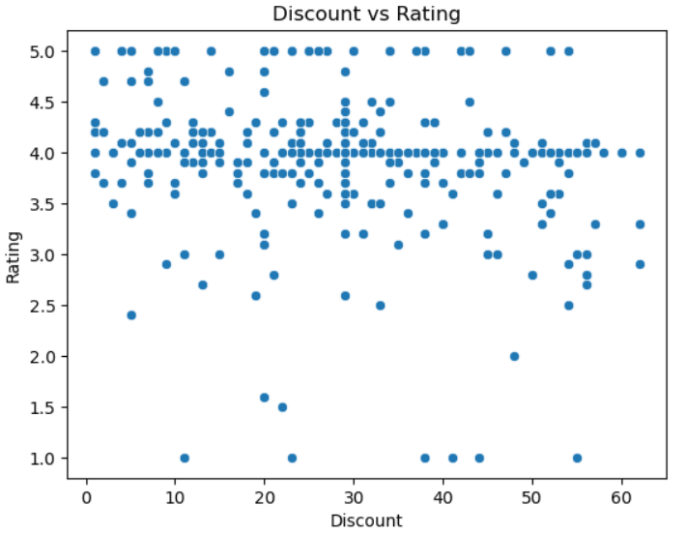
Bivariate Analysis:
Discount VS Rating:
Ratings stay mostly between 3.5
and 4.5 at every discount level,
so discount has no clear link with
rating. A few low-rated outliers
(1.0 to 2.5) appear across the
range. Customers seem to rate
laptops on quality and performance
rather than on how much discount they got.

Slide 13
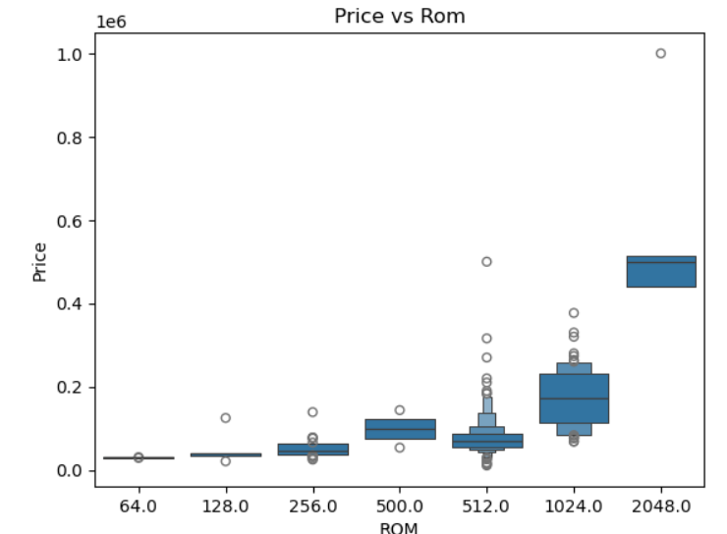
Price VS ROM:
Price rises with ROM: 64 to 128 GB
laptops are cheapest, 1024 GB
costs about 1 to 2.5 lakh, and 2048 GB
is the most expensive (about 4.5 to 5 lakh)

Slide 14
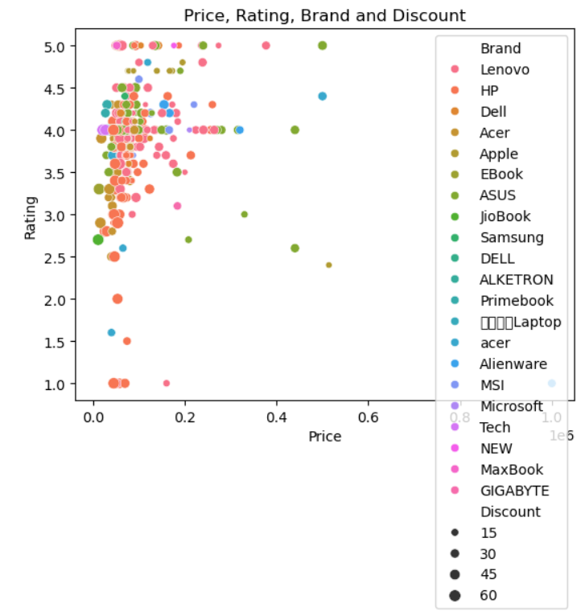
Multivariate Analysis:
Price , Rating , Brand and Discount:
Most laptops cost under 2 lakh and
are rated 3.5 to 5.0 across all brands.
Brand and discount show no clear
link with rating, and bigger discounts
mostly appear at lower prices.
The legend is crowded, so
group small brands as “Other”.

Slide 15
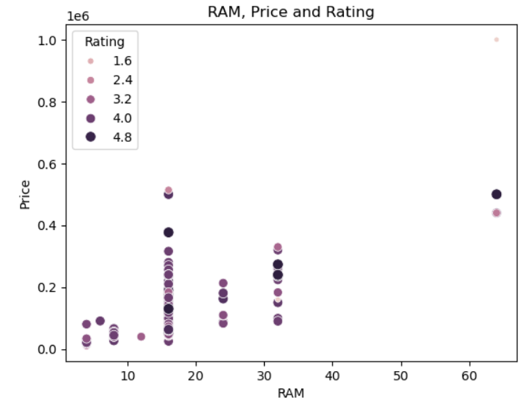
Ram , Price and Rating:
Price rises with RAM: 4 to 8 GB
laptops are cheapest, 16 GB is
the most common and spans a
wide price range, and 32 to 64
GB cost the most. Ratings show
no clear pattern with RAM, and
the 64 GB laptop near 10 lakh
is an outlier with a very low rating.

Slide 16
Insights:
Brand vs Price
Question: Is there a significant difference in average laptop prices among different brands?
H₀ (Null Hypothesis): There is no significant difference in average laptop prices among brands.
H₁ (Alternative Hypothesis): There is a significant difference in average laptop prices among brands.
Output:
F-statistic: 5.540343320702333
P-value: 4.0608494586152275e-12
Reject H0
Insight: There is a significant difference in average laptop prices among brands.

Slide 17
RAM vs Price:
Question: Is there a significant relationship between laptop discounts and prices?
Null Hypothesis (H₀): There is no significant linear relationship between laptop discounts and prices.
Alternative Hypothesis (H₁): There is a significant linear relationship between laptop discounts and prices.
output:
Correlation: -0.25558655822251525
P-value: 3.155796391044576e-06
Reject H0
Insight: Discount and Price have a statistically significant relationship.

Slide 18
Recommendations:
Compare laptop prices across different brands before purchasing.
Choose RAM and storage based on personal needs and budget.
Check customer ratings to understand product quality.
Compare discounts to identify better deals.
Focus on popular laptop configurations, such as 512 GB storage.
Businesses should review competitor prices and discount strategies.
Use data insights to improve product selection and pricing decisions.

Slide 19
Conclusion:
This project analyzed 324 Amazon laptop records to understand laptop market trends, pricing patterns, discounts, specifications, and customer ratings. The analysis helped identify popular brands, commonly preferred RAM and ROM configurations, processor categories, and different price segments. It also helped identify highly rated and value-for-money laptops by comparing their prices, specifications, discounts, and ratings. Overall, the insights can help customers make better purchasing decisions and help businesses improve their pricing, inventory, product selection, and marketing strategies.

Slide 20
Q&A Slide

Slide 21

THANK YOU

